Slide 1

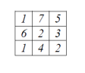

Digital Image Processing
33-Arithmetic mean filter
f (x,y) = 1/9 * (1+7+5+6+2+3+1+4+2) = 31/9 = 3.44

